Slide 1
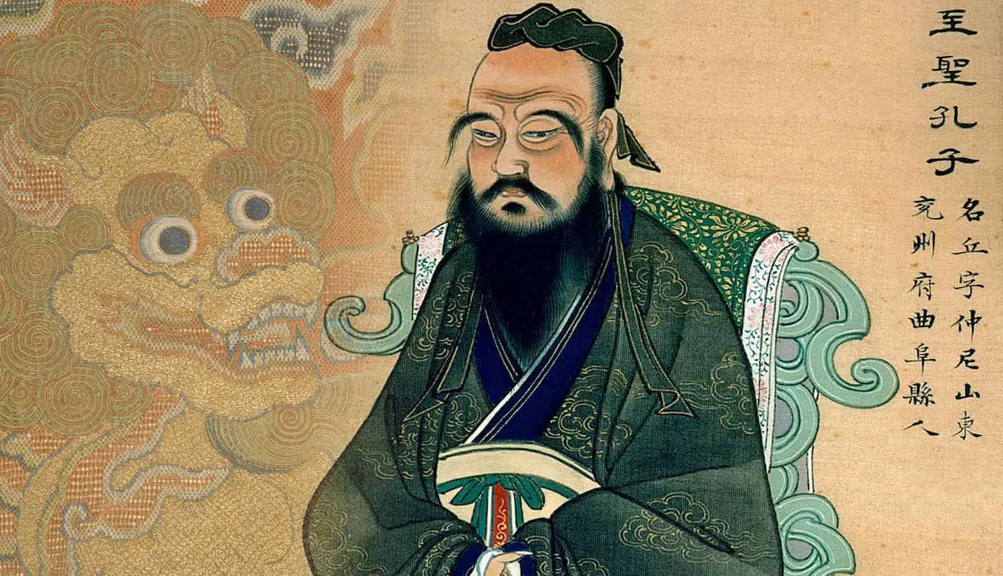
The Perennity of Confucius’ Teachings
Prof. Dr. Eng. Ecaterina Andronescu
“Confucianism seeks no other goal for man than to perfect his humanity by fulfilling his duties according to what is true and just: a father must be a father, a son must be a son.”
Mircea Eliade, Ioan P. Culianu

Slide 2
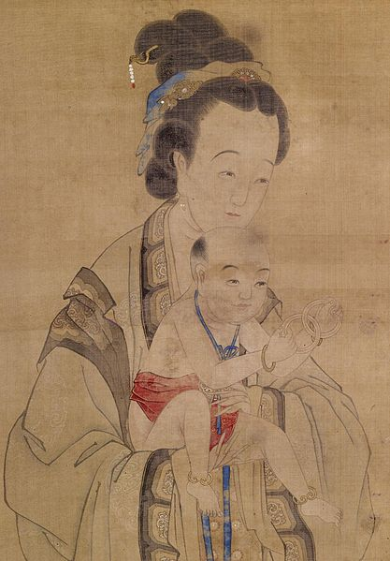
Childhood and youth
Confucius was born into a family of educated, learned people, with admiration for their ancestors. In the house of one of them, on a tripod – considered a sign of fate- the inscription was engraved “Do not walk on the road with a stoop. Accept with modesty the offered position that you will fulfill with humility and sincerity, and always respect your ancestors”, prefacing what Confucius left us;
His great-grandfather, grandfather, and father held important positions - district governors with responsibilities in civil administration and military defense [1];
His father, Shu Lianghe (Şu Liang hă), also known as Kang Ge, through deeds of courage and intelligence, enjoyed a great reputation;
Confucius’ mother, Yan Zhengzai (Ian Cengtai), the daughter of a scholar, married at the age of 13 to Confucius’ father, who was over 60 years old.

Slide 3
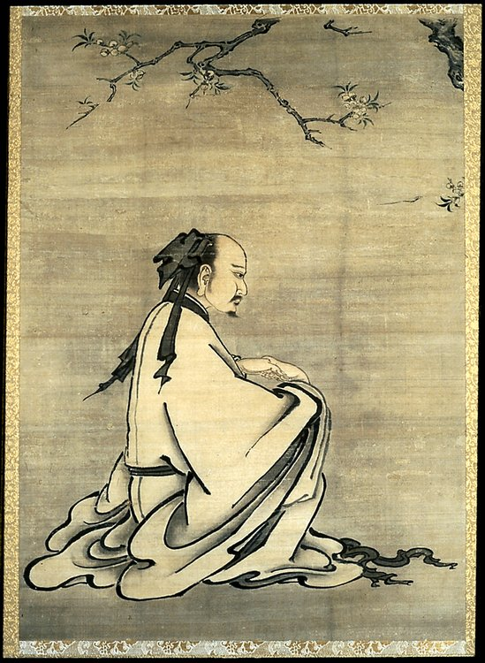
Childhood and youth
Confucius was born in an area of Mount Niqin, hastily identified by his parents;
The dry spring in the cave, the birthplace of Confucius, still flows today, being a testimony and symbol of Confucius’ birth and immortality [1];
“The date of birth of Confucius is recorded as August 27, 551 BC, in the 21st year of the reign of King Ling of the Zhen Dynasty and in the 22nd year of the reign of Prince Xiang of the Principality of Lu” [1];
Confucius’ father gave him the ancestral family name Kang and the name related to the birthplace – Mount Niqin, stylizing it as Zong Ni (the second name from Mount Niqin).

Slide 4
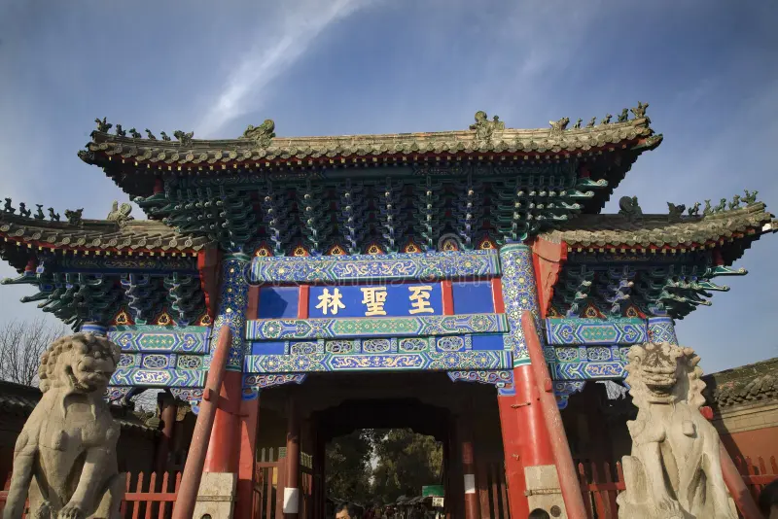
Childhood and youth
At the age of 3, he loses his father and returns to his maternal grandparents' house, from whom he learns the complicated Chinese hieroglyphs from the age of 5;
From the age of 12-13, he was appreciated for his accumulated knowledge and musical talent, but also for his love for ancient and wise kings, skills instilled by his mother and grandfather;
The exhausting work to support the family brings the early death, at only 40 years old, of his mother;
In the place where his parents rest for eternity, a memorial temple was built, a place of veneration and pilgrimage.

Slide 5
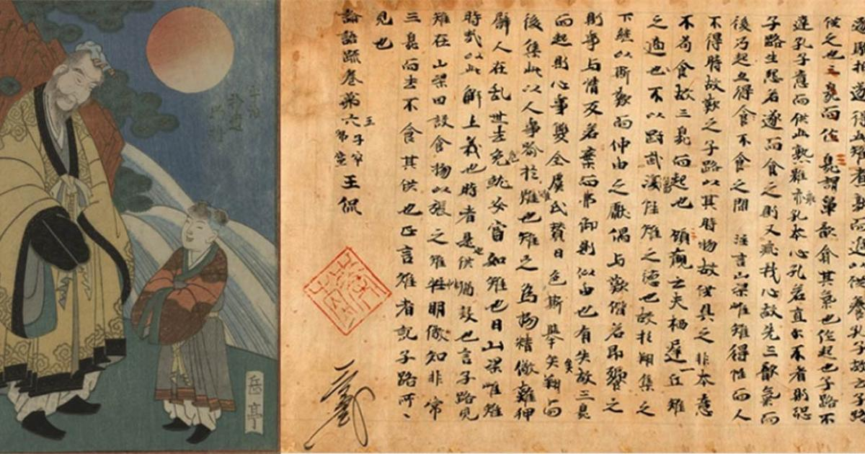
Childhood and youth
About Confucius, it was written posthumously that from the age of 12-13, he had become appreciated "for his accumulated knowledge and for his musical talent";
His mother and grandfather educated him in the spirit of love and respect for the ancient kings and urged him to study the fields of history, archeology, and the "Book of Changes";
He was also instilled with the idea that he had wise ancestors and, therefore, the responsibility to carry on the family tradition;
The death of his mother determined, from the age of 17, not only to lead a modest life, but to be forced to work, without abandoning his studies;
Thus, he became a cattle herder for a landowner whose employment was conditioned by access to his collection of books.

Slide 6
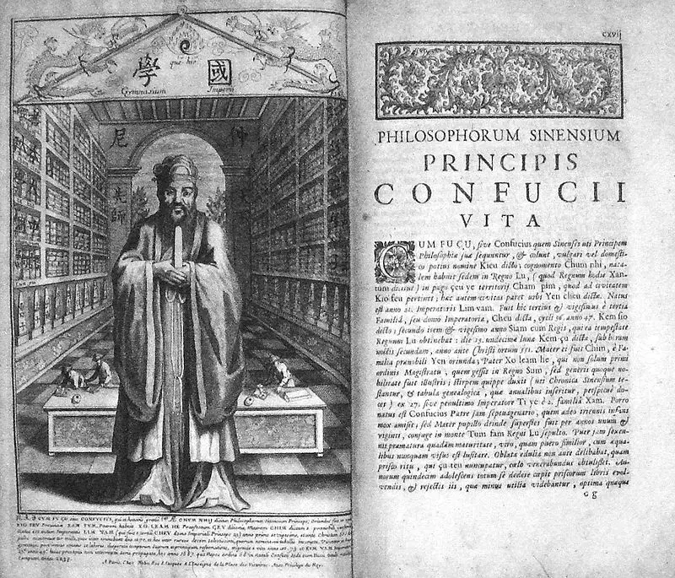
The work of Confucius
Access to the landowner's books, the position of cattle herder, but especially his intelligence, allows the young Confucius to clarify and consolidate his conception of society and life;
He notices the unfairness of subordination relations in work;
He affirms the need to consider fair living conditions, humane treatment in the master/subordinate relationship;
He speaks out against subordination and social stratification;
He gives up the instrument of power that had been entrusted to him as a small servant (abandoning the whip);
He proposes to the other cattle guards to "act together" to build huts, to have a schedule, a meal;
He initiates new apprentices such as: bricklayer, carpenter, archer, etc.

Slide 7
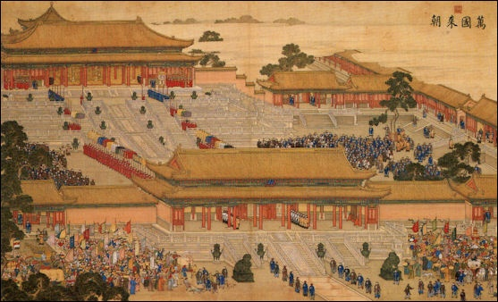
The work of Confucius
He evolves through wisdom, through the respect of those who listened to him, but also through humility;
He develops his profession as a source of livelihood through a rabbit farm;
He also continues his studies of history, literature, and rituals;
Music becomes a constant preoccupation for him;
He plays bells, gongs, and the zither, reaching perfection and attracting the appreciation of the musicians at the Royal Court;
At 20 years old, Confucius becomes an educated man, with proper manners, deeds, benevolent gestures, and polite and decent behavior [2];
He constantly behaves with propriety;
He was calm, controlled, and dignified by the ceremonial of the Imperial Court.

Slide 8
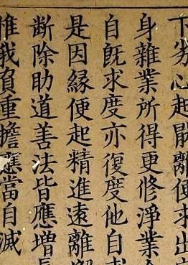
The work of Confucius
He clearly states that the passion for gain is the source of social unrest;
A social position must allow the perfection of the personality of the one who obtains it;
Conclusion: “nothing can be achieved in the world, not even in the most influential position, without the qualities acquired through education”;
No total fulfillment can be achieved except through intense study;
Thinking without the fruits of reading is barren”;
“He who leads by the power of virtue, acquired through education, is like the North Star”: he stands in his place, and all the other stars worship him”;
Confucius says: “At 15 I began to learn with all my will. At 30, my creed was already well-founded. At 40, I got rid of doubts. At 50, they found out the Date of Heaven. At 60, I understood everything I heard. At 70, without violating the Rules (Laws), I followed the desires of my heart.”

Slide 9
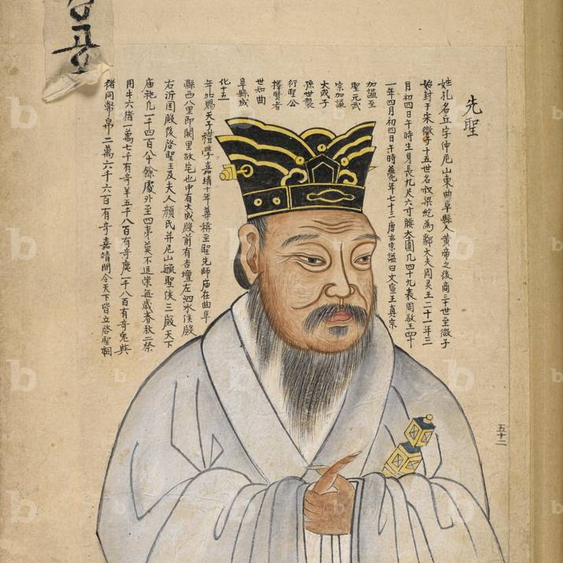
The work of Confucius
When asked by a King: How can I make the people follow me obediently?
Confucius answers: “Those who follow the Right Path should be placed above those who choose the crooked one. If you push the right ones away and bring the wrong ones closer, the people will not follow you”;
“The scholar devotes himself entirely to the Right Path; if not, he is not worthy to be your teacher”;
He who serves his own self-interest attracts only disapproval and hatred;
Be true to yourself, respecting others.

Slide 10
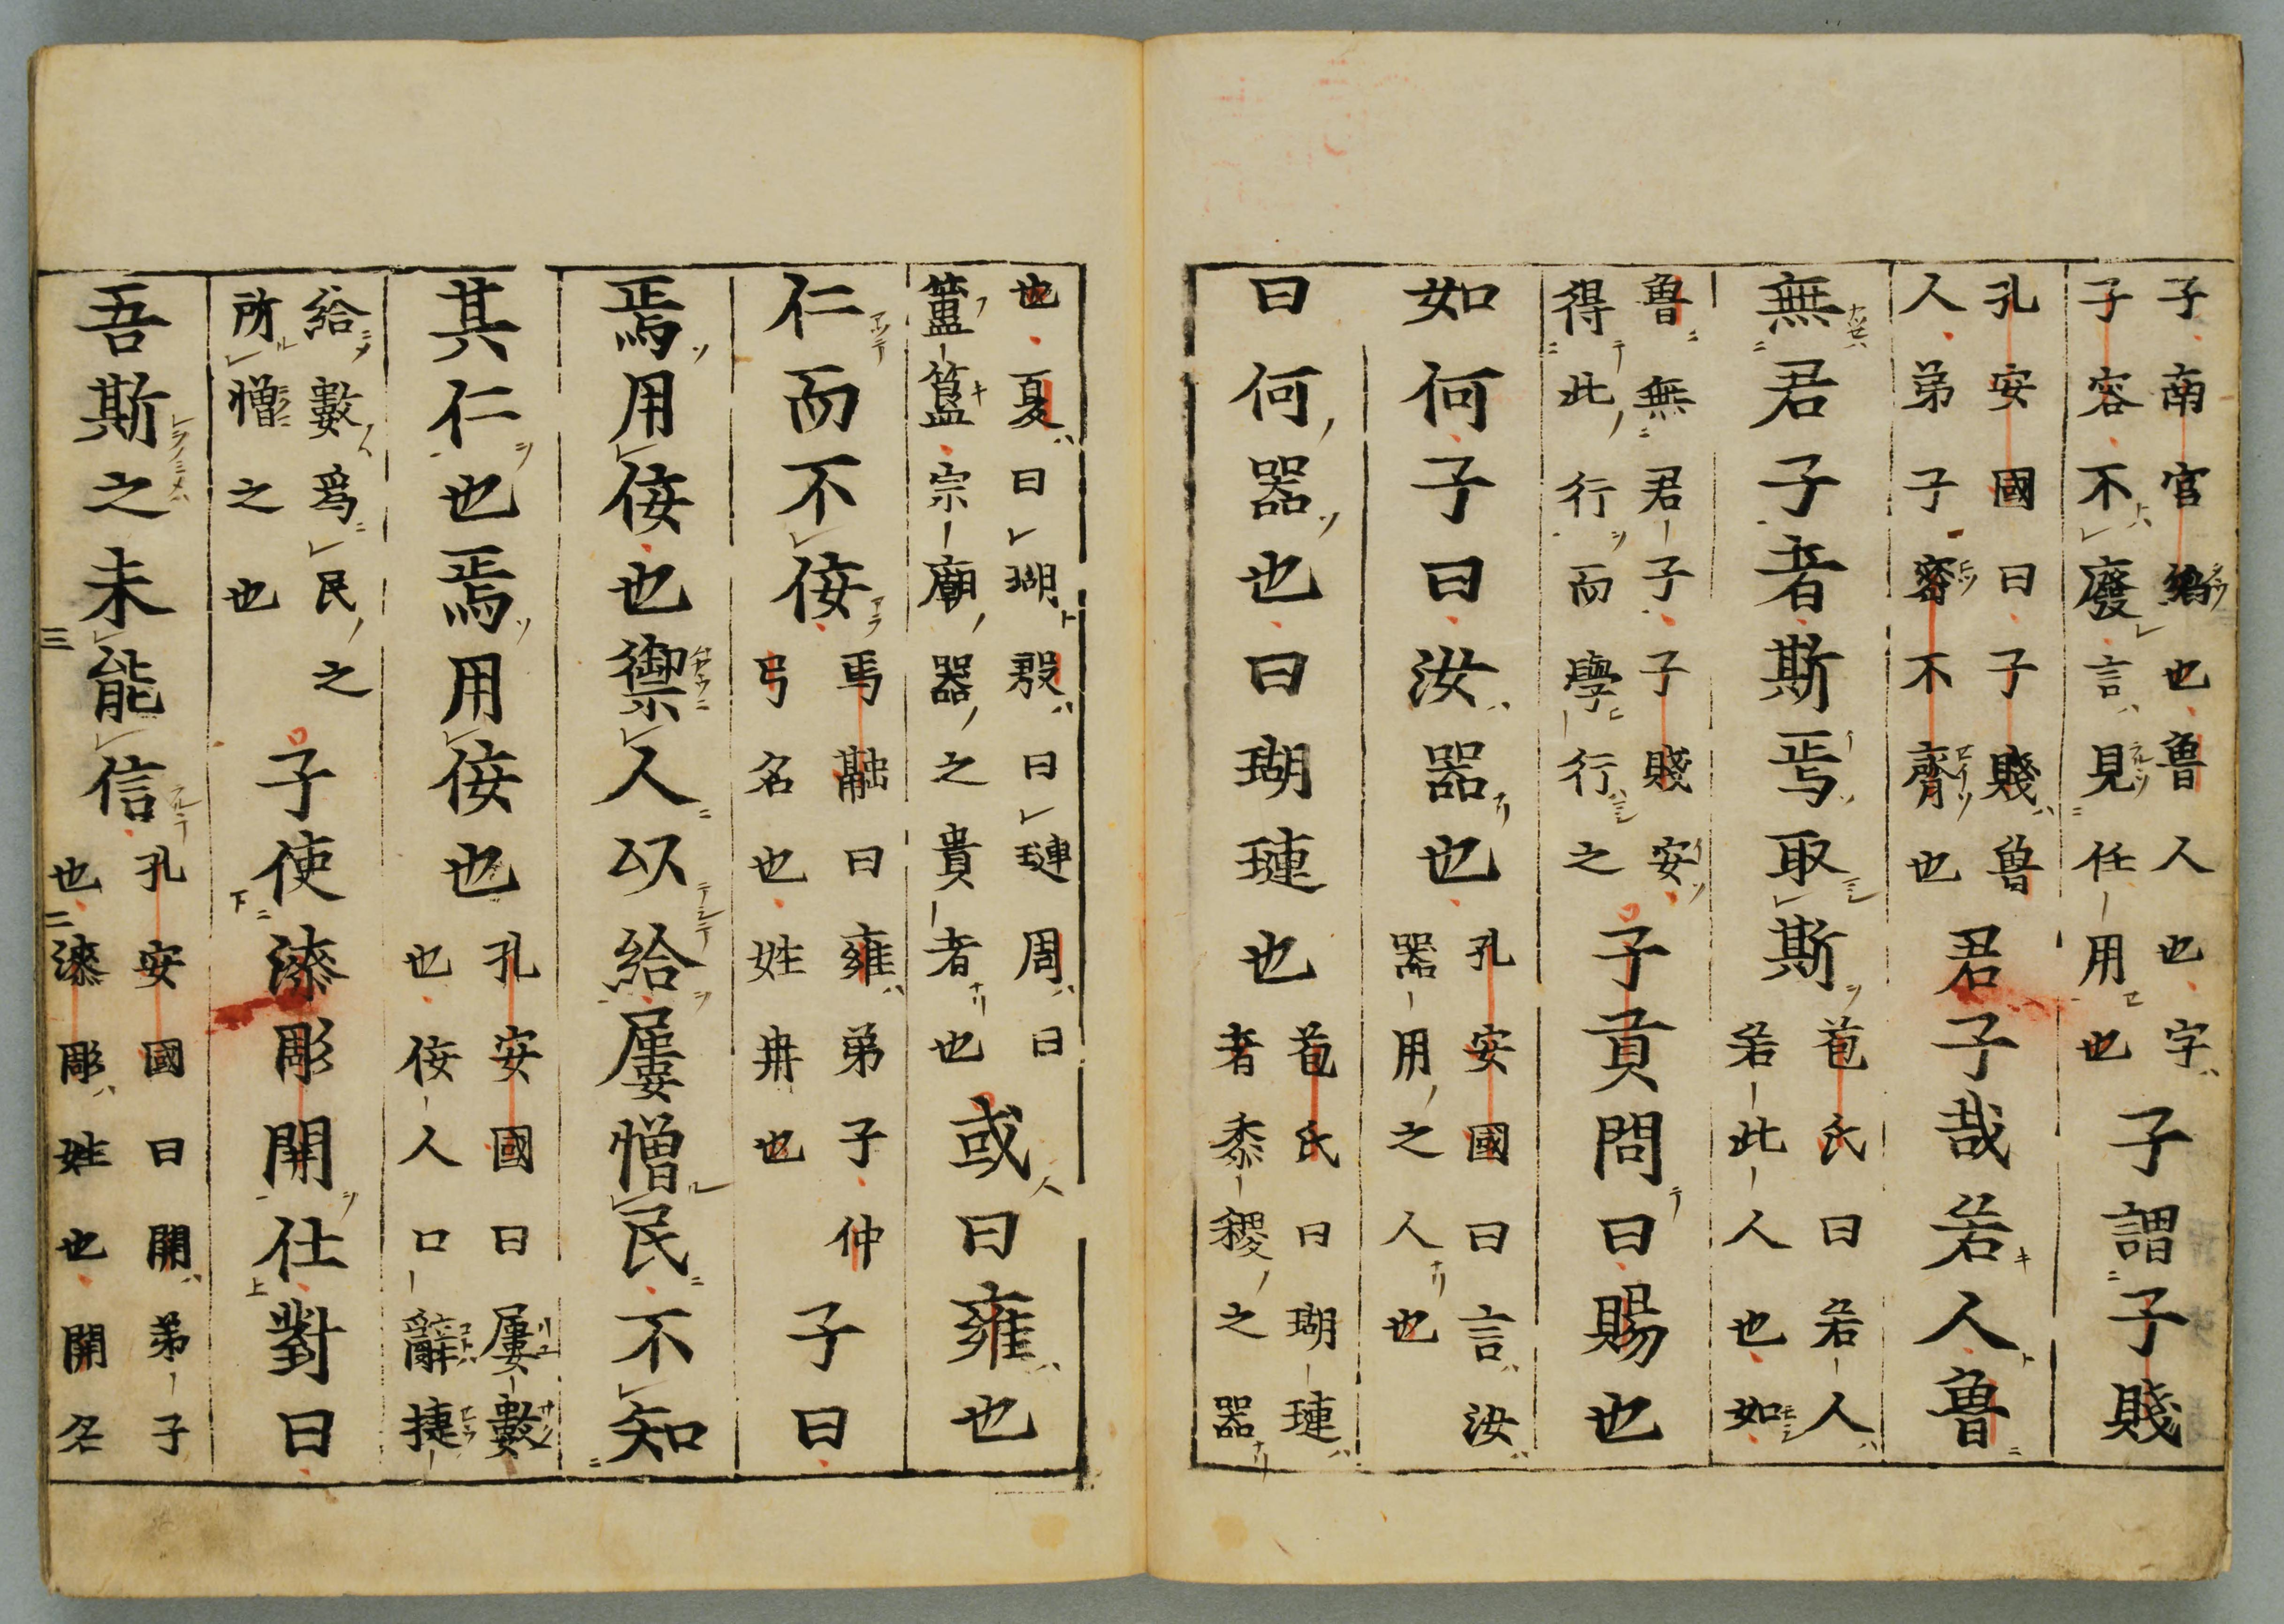
Confucius School
Confucius, the creator of the first private school in China, and around the world
Life experience and accumulated knowledge do not lead him to stop learning, but he considers it a necessity to share his teachings with his disciples;
He organizes a school of traditional teaching that would improve the decline of morality in society;
The school was opened, according to historical data, in 522 BC, when Confucius was 30 years old;
The school opens in his own home;
Students aged between 15-50;
The school becomes famous, and the number of students also increases from neighboring principalities;
Essentially, and as a world priority, the Confucius school was open to all who wanted to study without discrimination based on social status, and treated nobles and the poor equally

Slide 11
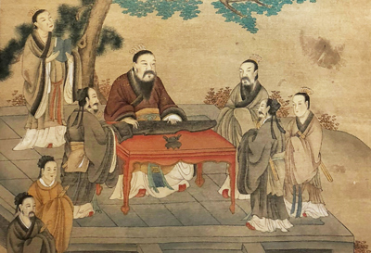
Confucius School
Professor Confucius was gentle, benevolent, modest, and tolerant, say the books about his.
What was taught at the school of Confucius:
Respect for parents and ancestors;
About the superior Man → who first acts, and deeds speak of him;
Respect for others, without insults and without offenses;
A man must be tireless in work and moderate in speech;
About learning and thinking;
Impartiality in words and deeds;
About virtue and its social role;
Harmony – without which order is disturbed, nothing can be built;
About the poor and worthy. About the rich and unbridled in pride.

Slide 12
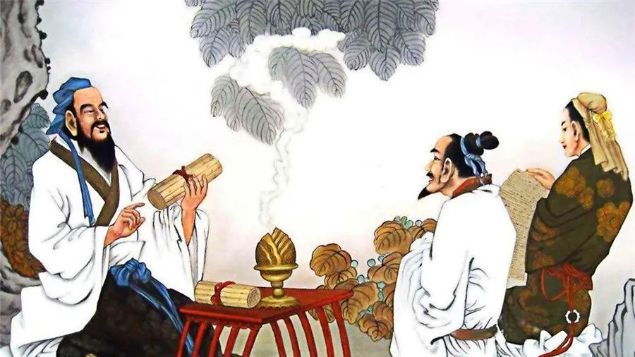
Confucius School
What does knowledge mean;
Justice for yourself and for your fellow men;
On the elevation of the just, good, and learned, and on the teaching of the unskilled;
On righteous deeds and courage;
Appropriate conduct, loyalty to one's country and people, what is said must be done;
The Virtue of Humanity;
Governance with virtue, laws, and through music;
To be poor and not to blaspheme, to be rich and not to be proud;
On the instruction of the order without imposition.

Slide 13
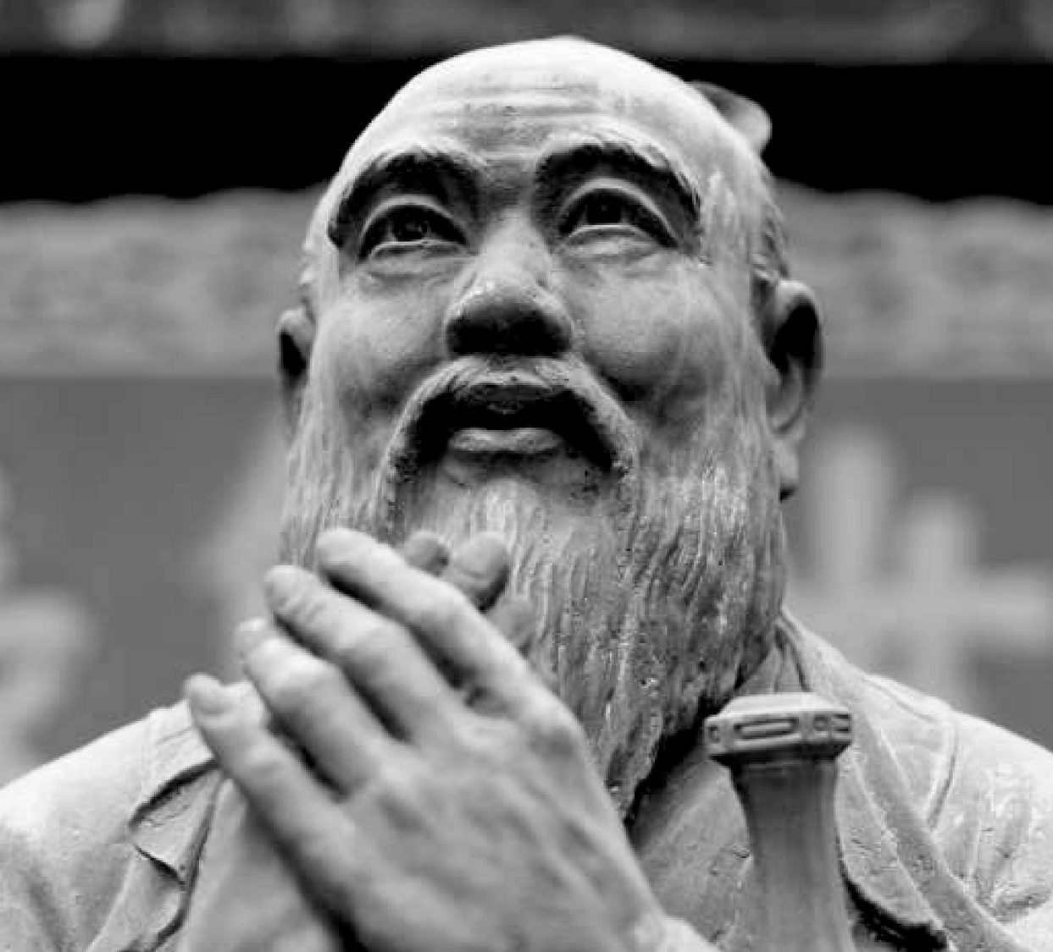
Confucius School
How laws are made:
Official X composed it
Official Y researched and consulted it
The Minister of Foreign Affairs improved it
The PM perfected it;
About the nature of people that brings them together and the Learning that makes the difference;
Intelligence and Stupidity cannot be changed.

Slide 14
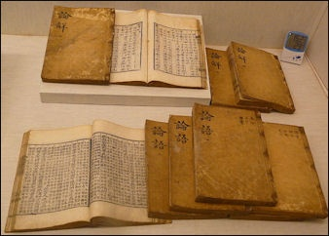
From the teachings of Confucius
“Rotten wood cannot be shaped” - is another wise saying of Confucius, said in his venerable years, which completes the idea of selecting with predilection for genetically gifted and morally unblemished elements.
“In whatever you do, do not rush and do not run after easy gains”.
“Whoever is humane is never restless; who is wise is never confused; who is brave is never afraid”. By this, Confucius considers that humanity, wisdom and courage are the three universal virtues. They are mutually linked. Wisdom leads to the knowledge of humanity, and courage to its practice.
“Virtue is the root”. TEverything that exists has roots and branches; Confucius emphasizes the primordial importance of the root and draws an analogy with man, revealing that if he is properly rooted, “all the branches bloom”.
The virtuous sage can change the world when followers of virtue and humanity join him.

Slide 15
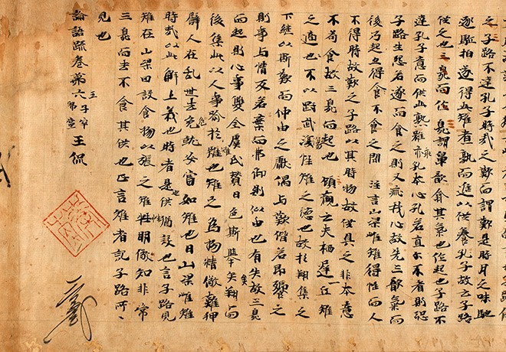
From the teachings of Confucius
In interpreting this idea, Confucius appeals to the deeds of the “Five Wise Emperors” from Chinese history, showing:
when they wanted to exemplify the nature of virtue, they first strove to govern their kingdoms properly;
wanting to govern their kingdoms properly, they first put their families in order;
wanting to put their families in order, they first educated themselves;
wanting to educate themselves, they first corrected their souls;
wanting to correct their souls, they first sought to have sincere intentions;
wanting to have sincere intentions, they first sought true knowledge on the soul level.
Thus:
- their thoughts being sincere, their souls were corrected;
- their souls being corrected, they could educate themselves;
- their families were corrected by self-education;
- by putting their families in order, the kingdoms were governed properly;
- by kingdoms being governed properly, the world enjoyed peace, good understanding, prosperity, and happiness.

Slide 16
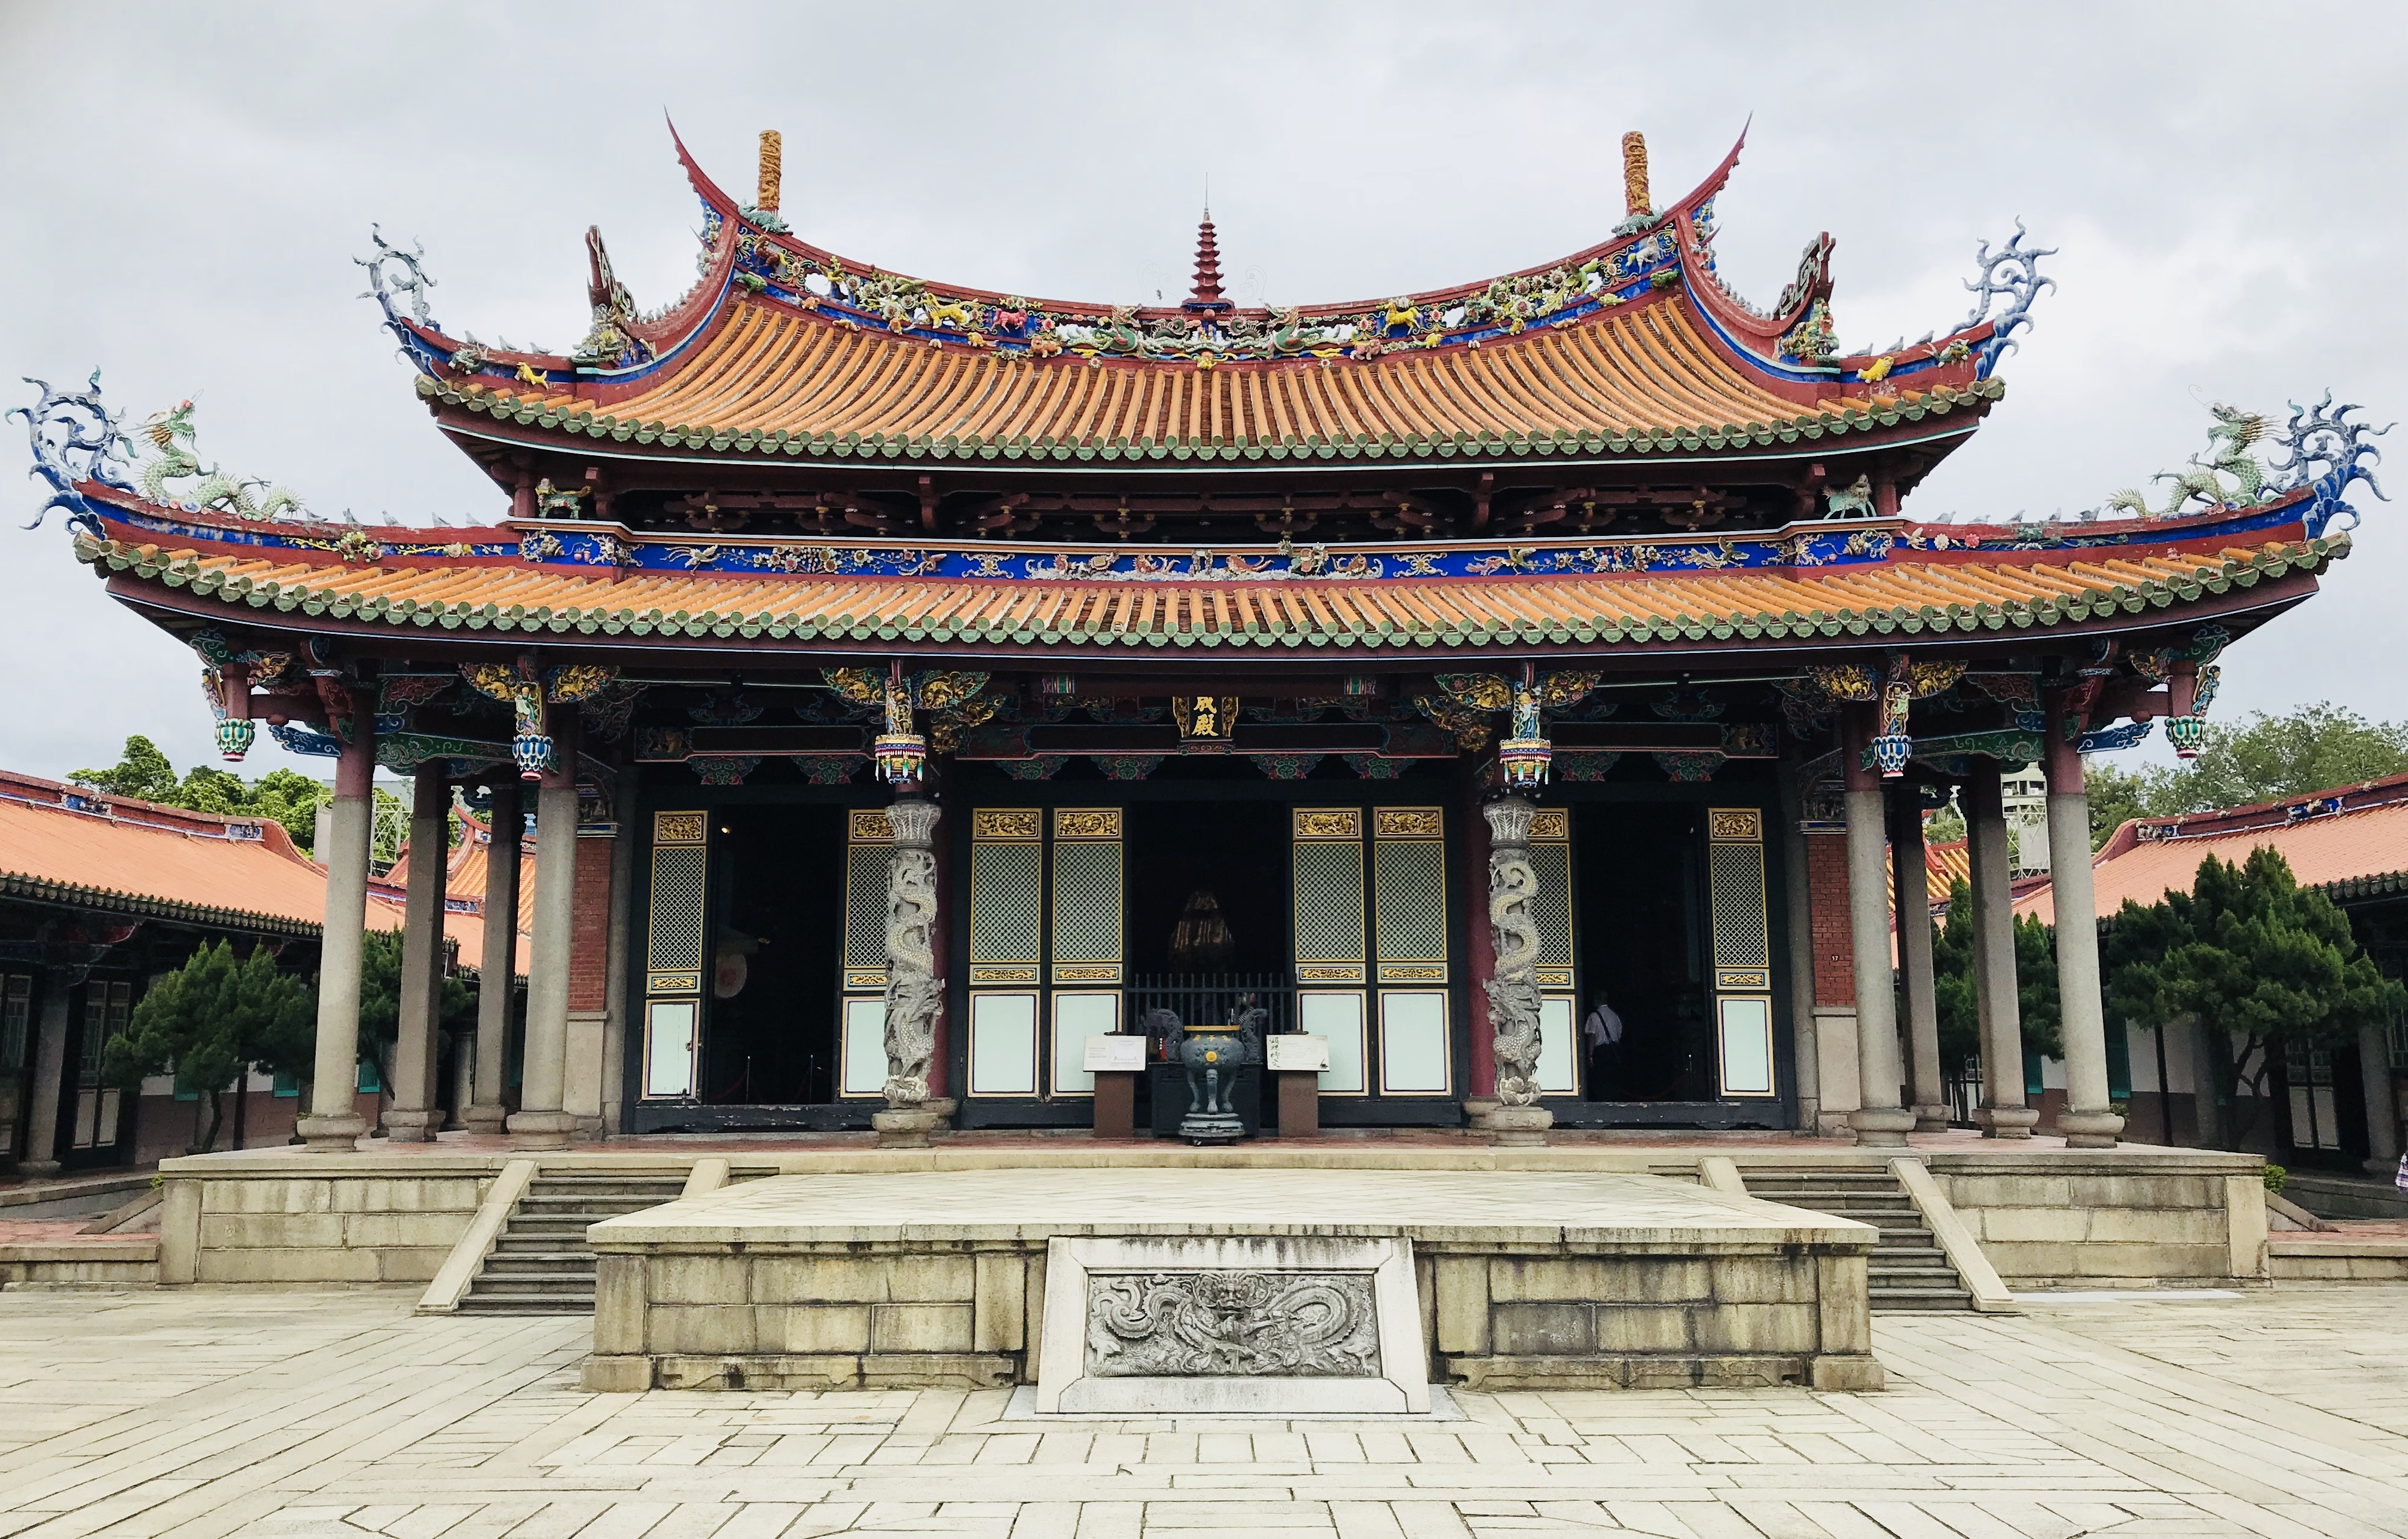
From the teachings of Confucius
Through continuous education, individuals are transformed, moving in the right moral direction. Starting from his own example,
Confucius distinguishes seven stages in human development and existential understanding of life:
from the age of 15, you realize the importance of learning and work;
at the age of 30, you must achieve and manifest yourself effectively in your chosen professional career;
at the age of 40, you distinguish the true meaning of the words of others, to no longer be influenced by them;
at the age of 50, you can lead others wisely;
at the age of 60, you realize the destiny destined by heaven;
at the age of 70, you enjoy accomplishments and leave your descendants what you have achieved;
from the age of 80, you live, thanking Heaven, in harmony with nature.

Slide 17
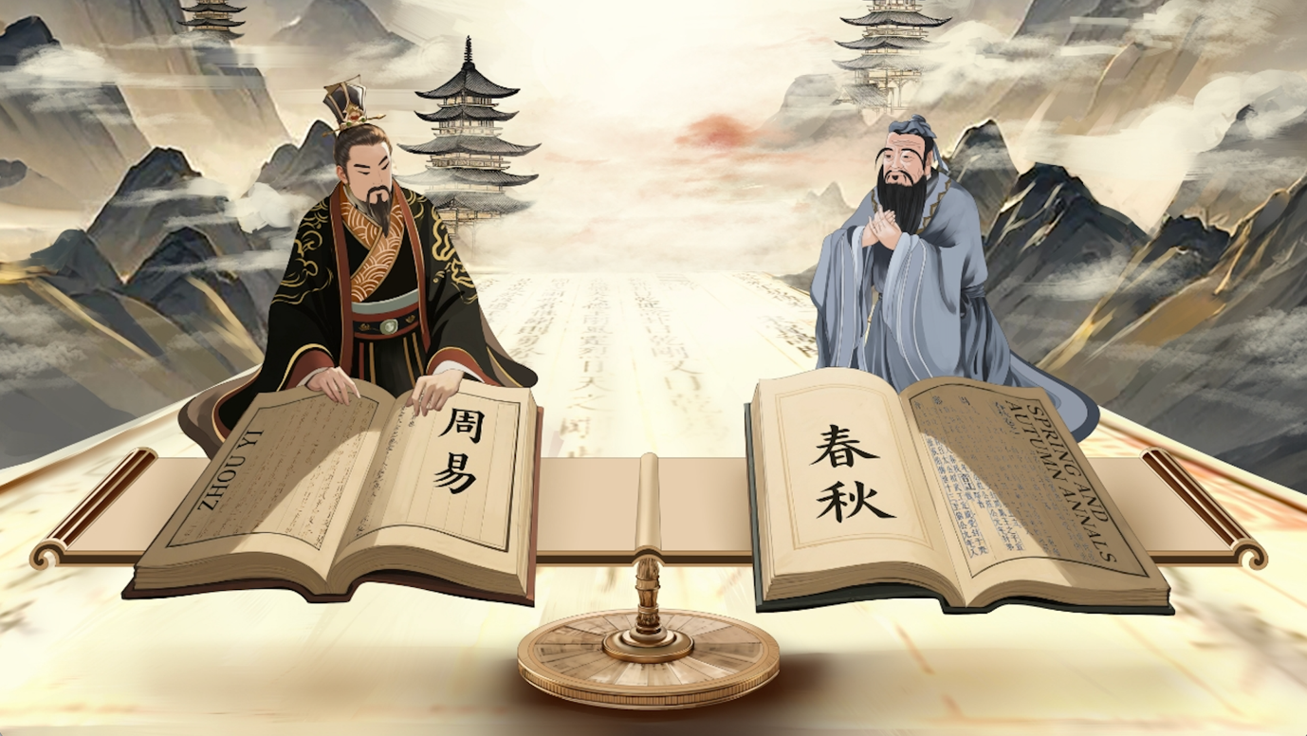
In brief...
Confucius developed and promoted knowledge through ethics and morality.
Confucius rationally approached the study of nature and all things with positive effects on the development of sciences in ancient China.
Confucius sought a holistic view of natural phenomena to promote harmonious coexistence by treating humans as part of the ecosystem.
Confucius, through "good manners" and order in interactions with materials, influenced Chinese alchemy and the study of the properties of substances for medicine.
Confucius promoted intensive study and respect for education, elements that contributed to the later success of the exact sciences.
Confucius promoted and supported a systematic, ethical, and observational approach to nature, emphasizing knowledge and the importance of education.

Slide 18

Bibliography
Ion Buzatu: “Viața și gândirea lui Confucius”, Meteor Press, 2009
Max Weber: “Analecte”, Cartex, 2025
Confucius: “Analectele lui Confucius”, Traducere Xu Wende, Ideea Europeană, 2022
Confucius: “Cartea cântecelor”, Traducere Xu Wende, Ideea Europeană, 2022

Slide 19
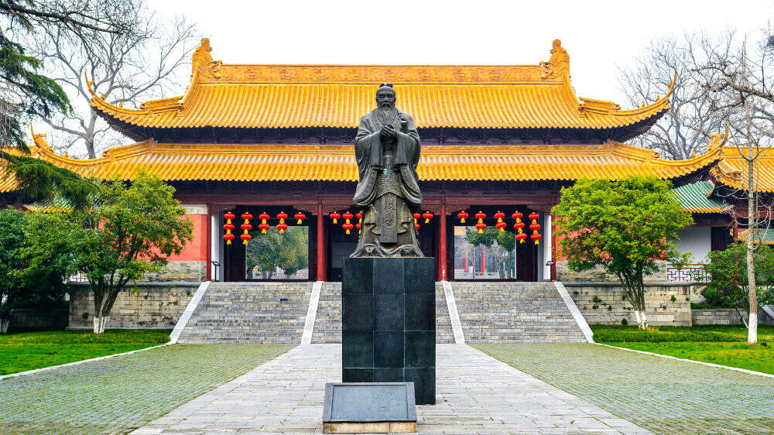
Thank you for your attention!

