Slide 1

The Anti-poverty Path with Chinese Characteristics”
Marcela GANEA
Belt and Road Research Lab
Bucharest, Romania
y4ww@yahoo.co.uk

Slide 2
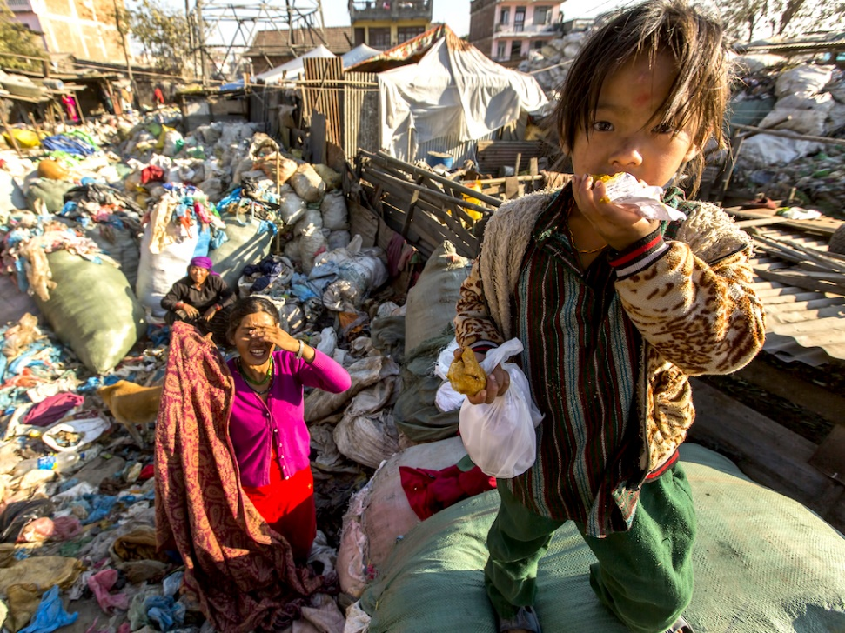
Status
World Poverty Clock
Worldometer.org
As we speak, about 8.2% of the world’s population live in extreme poverty with less than 3 USD per day, about 24% of the world’ population live on less than 5 USD per day and 52% live on less than 10 USD per day...

Slide 3
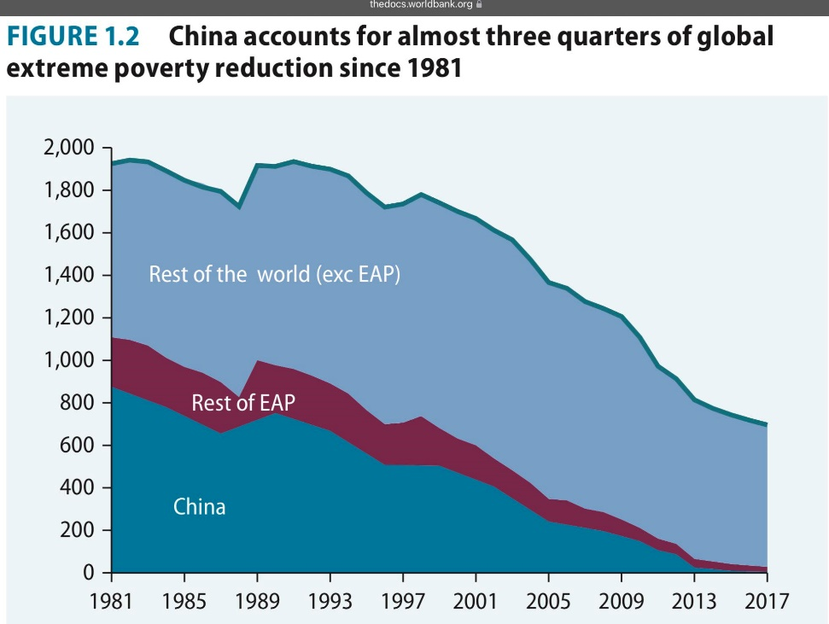
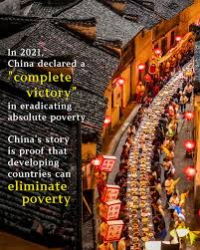
Poverty eradication is possible = political will+ holistic strategy

Slide 4
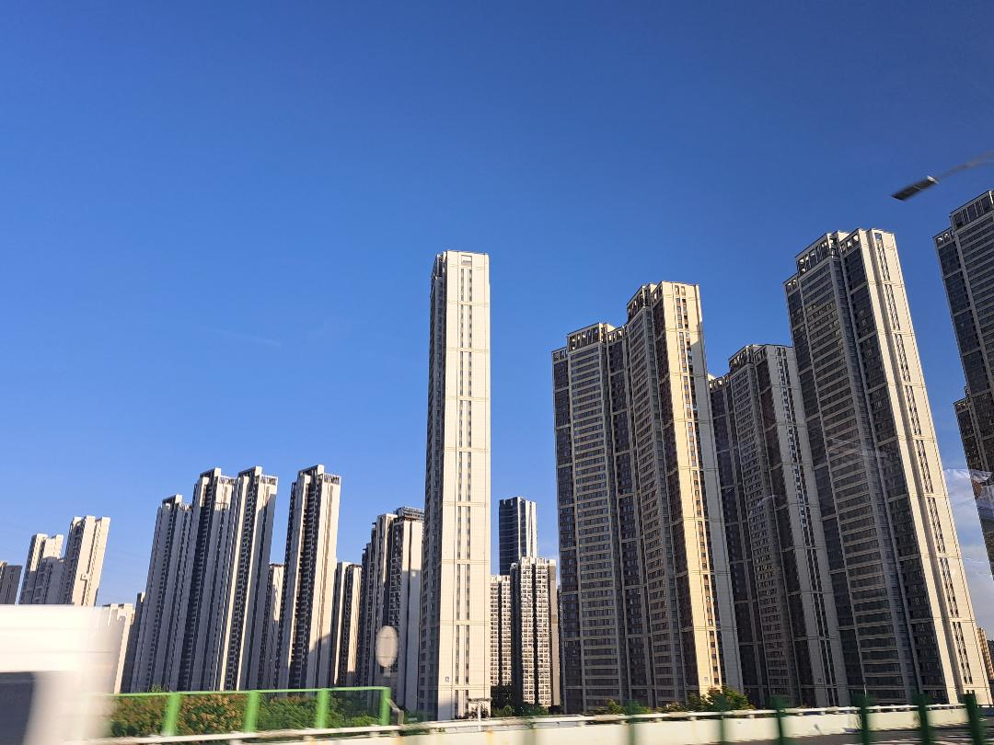
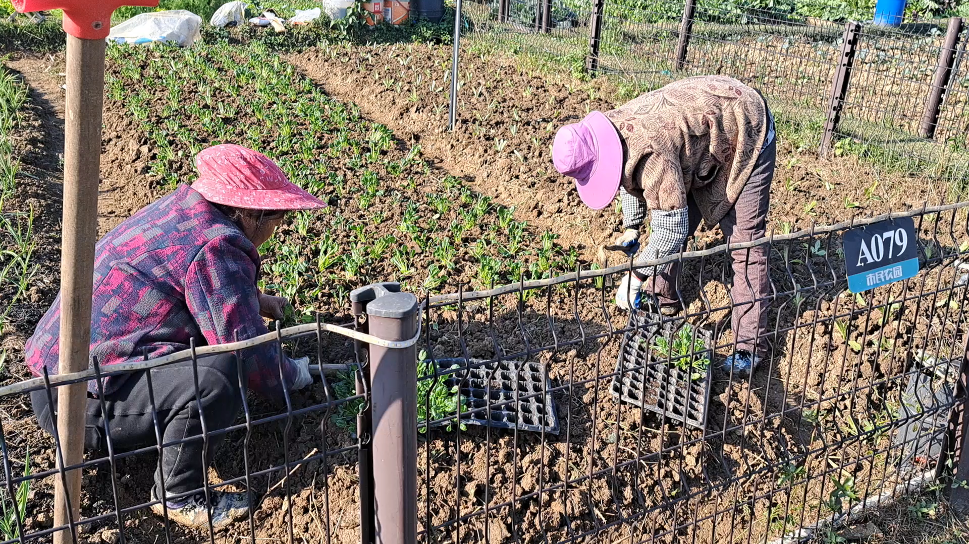
Countryside China in 2026

Slide 5
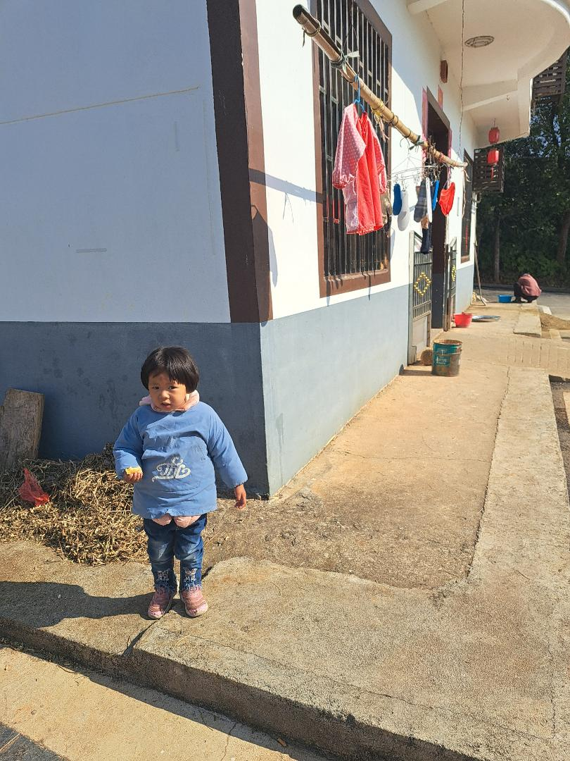
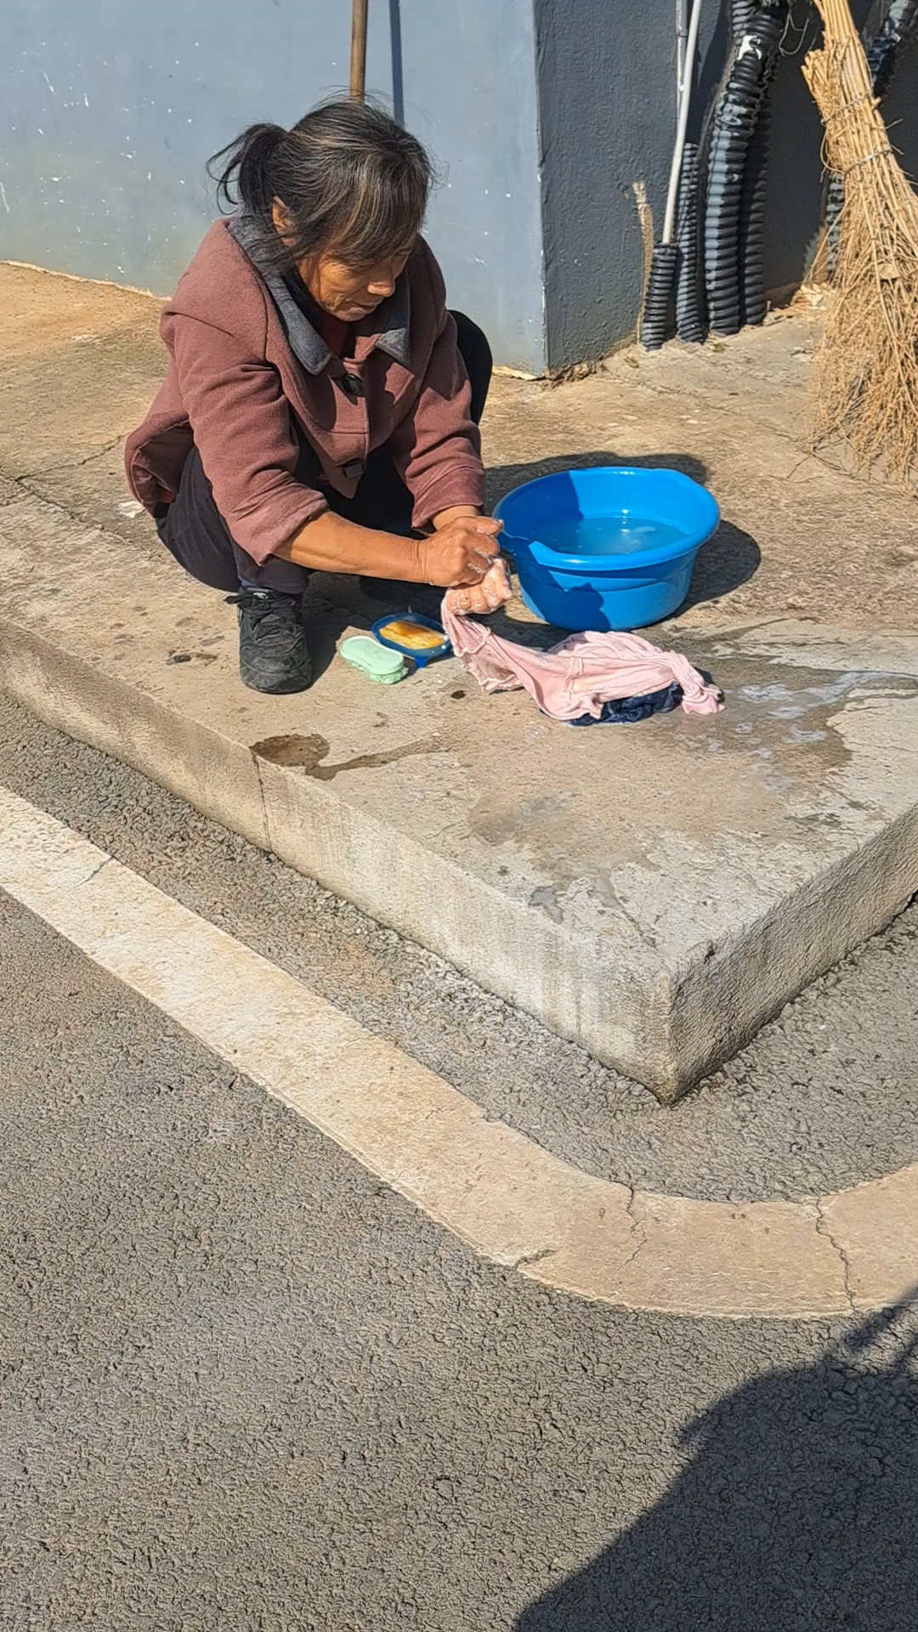
Countryside China in 2026

Slide 6
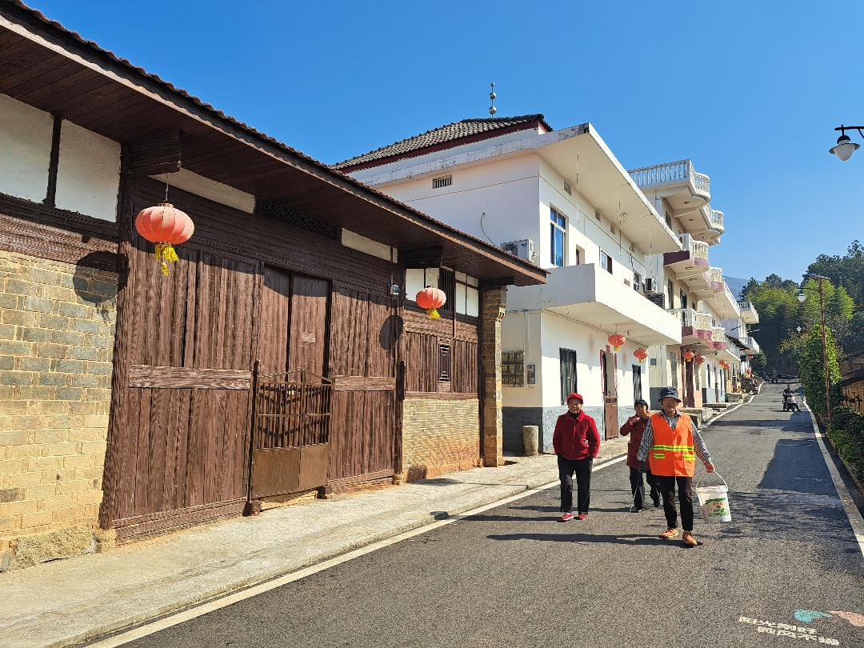
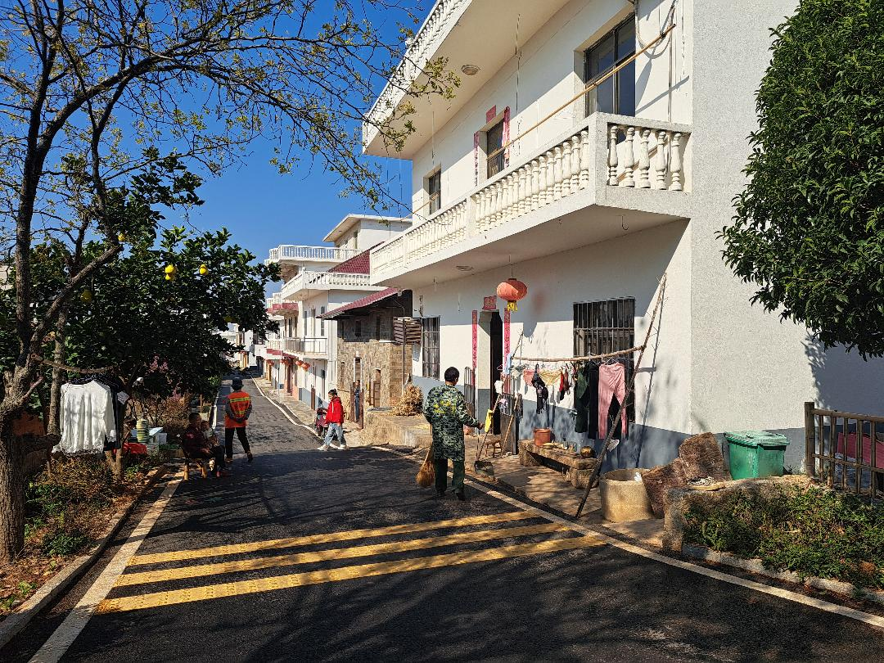
Countryside China 2026

Slide 7
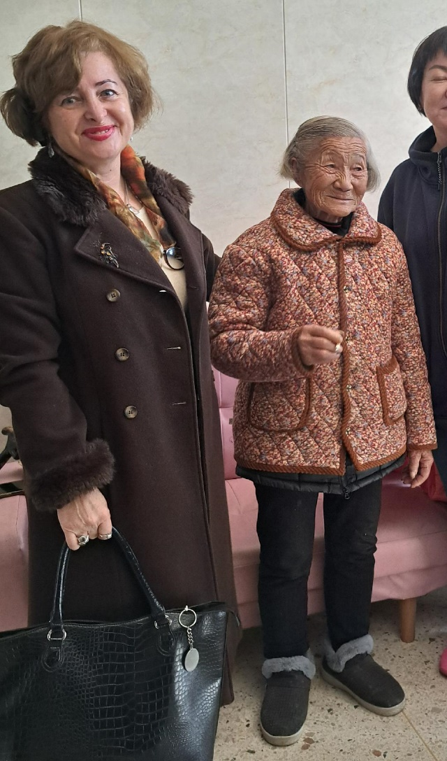
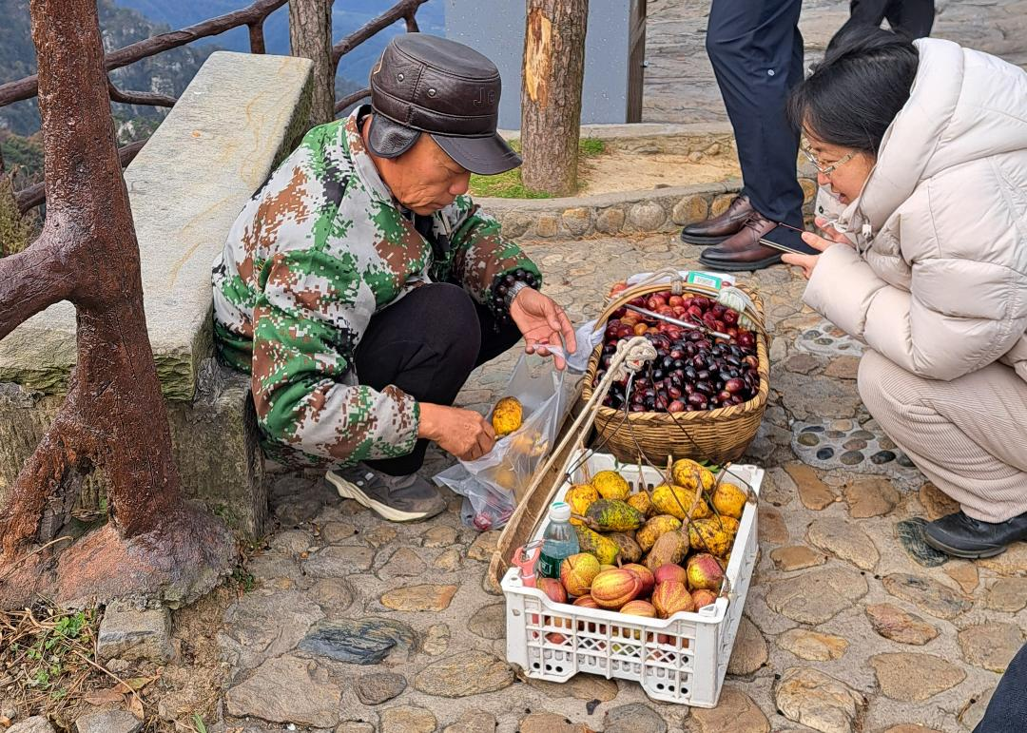
Countryside China 2026

Slide 8
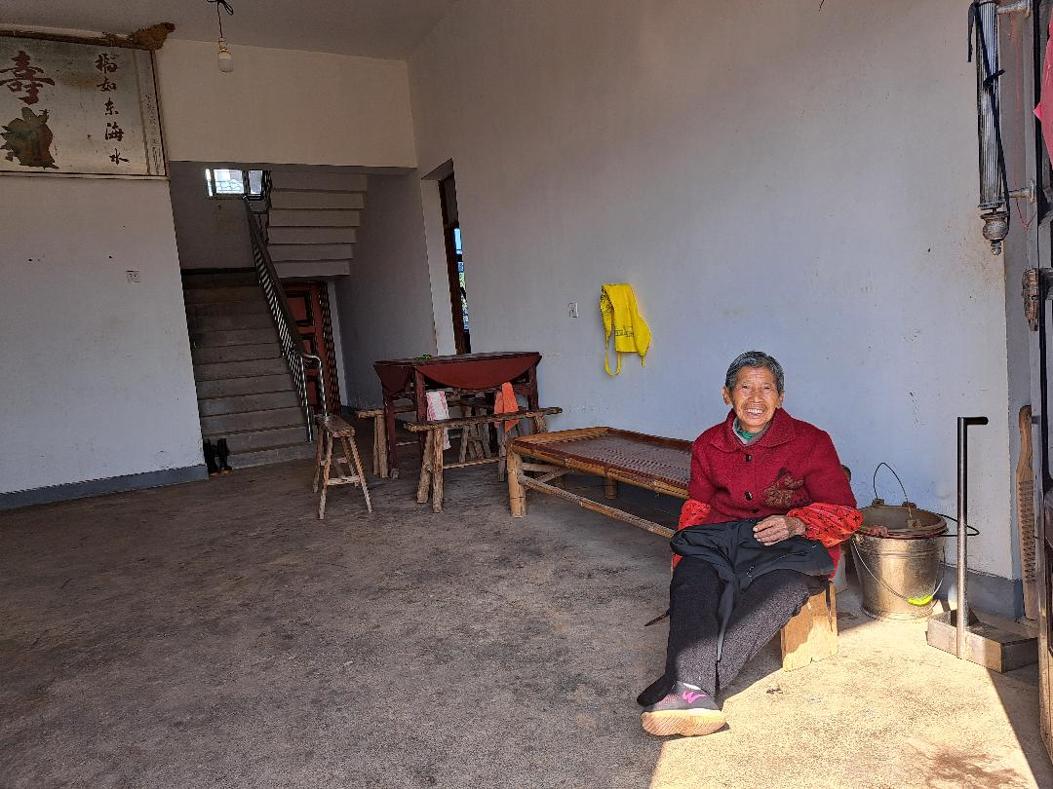
Contact: y4ww@yahoo.co.uk
Thank you for your time !
Marcela GANEA

